Slide 1
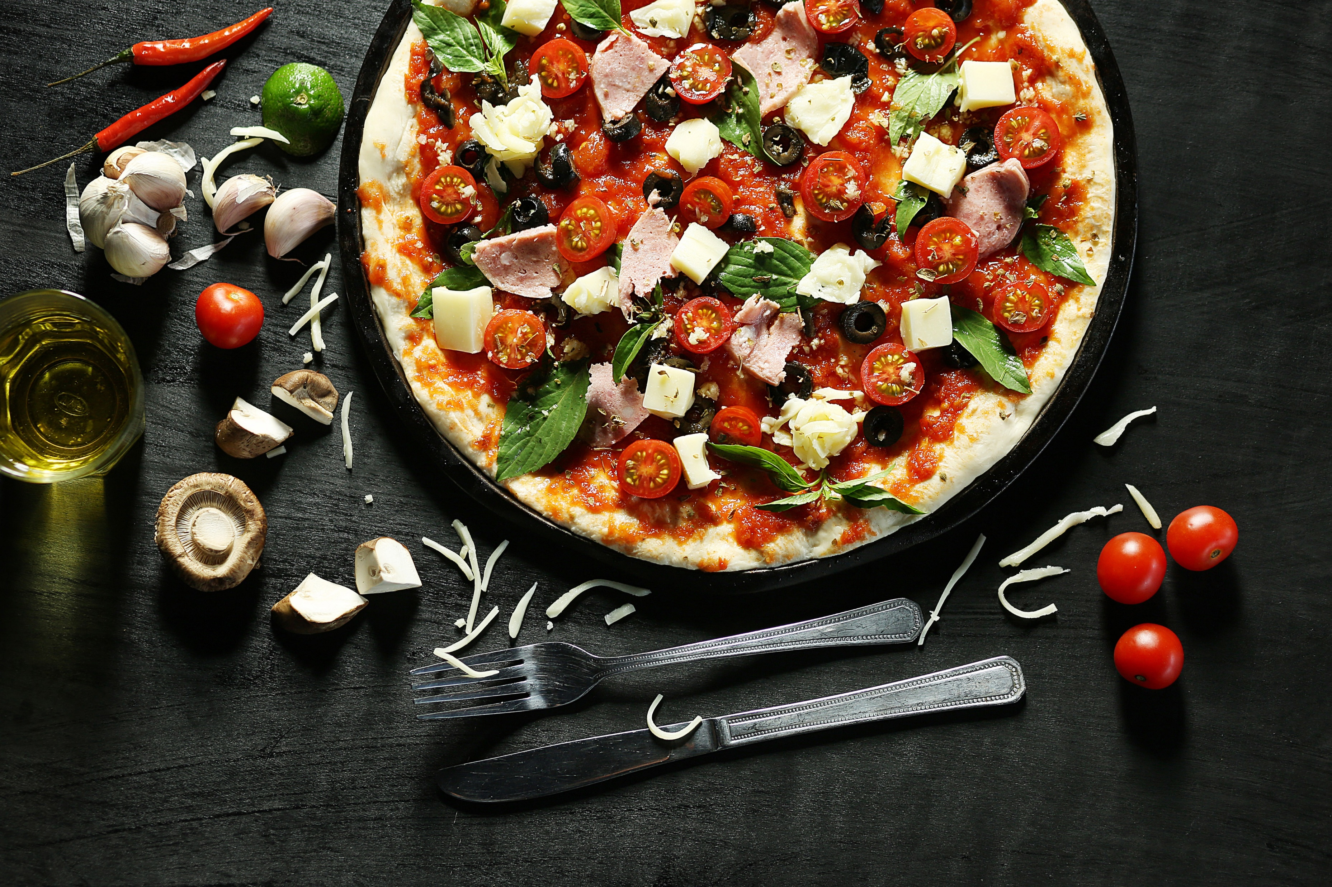
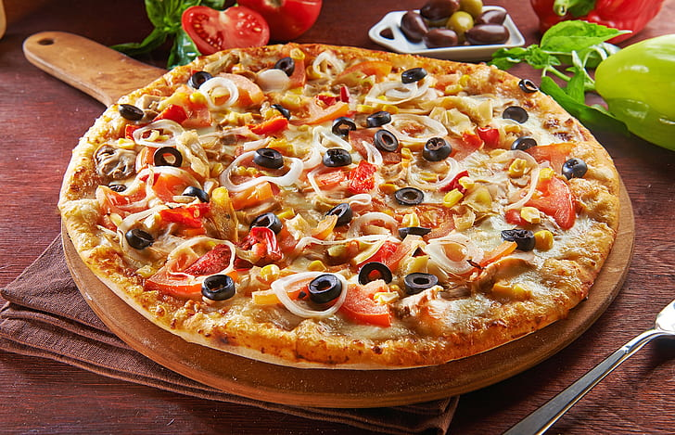
Pizza Sales Report
A complete SQL based project

Slide 2
Introduction
Welcome to the Pizza Sales Project presentation. This analysis focuses on understanding and optimizing pizza sales performance through data-driven insights. Our dataset includes detailed records of transactions, customer preferences, and product performance.

Slide 3
Project Objective
Analyze Sales Trends:
Identify peak sales periods and best-selling pizza varieties.
Customer Preferences:
Understand customer demographics and preferences.
Revenue Insights:
Evaluate revenue patterns and highlight high-performing products.
Operational Efficiency:
Optimize inventory and supply chain based on sales data.

Slide 4
Basic Level Queries

Slide 5
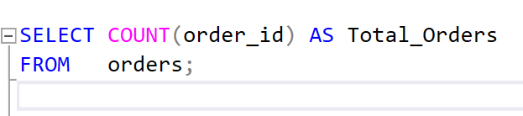
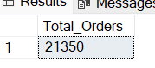
1.Retrieve the total number of orders placed.

Slide 6
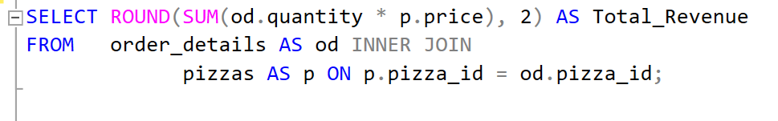
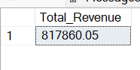
2.Calculate the total revenue generated from pizza sales.

Slide 7
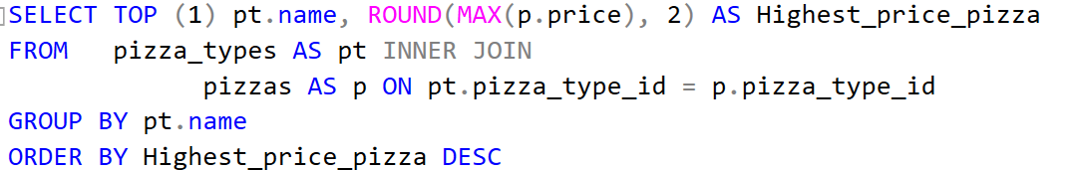
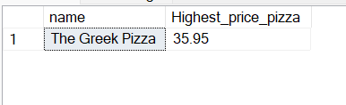
3.Identify the highest-priced pizza.

Slide 8
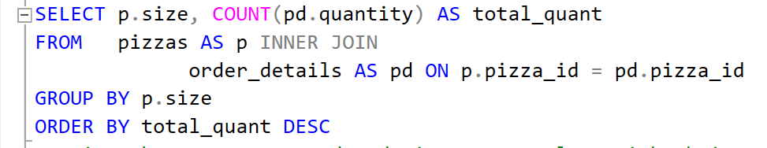
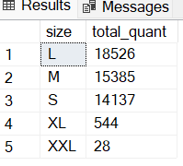
4.Identify the most common pizza size ordered.

Slide 9
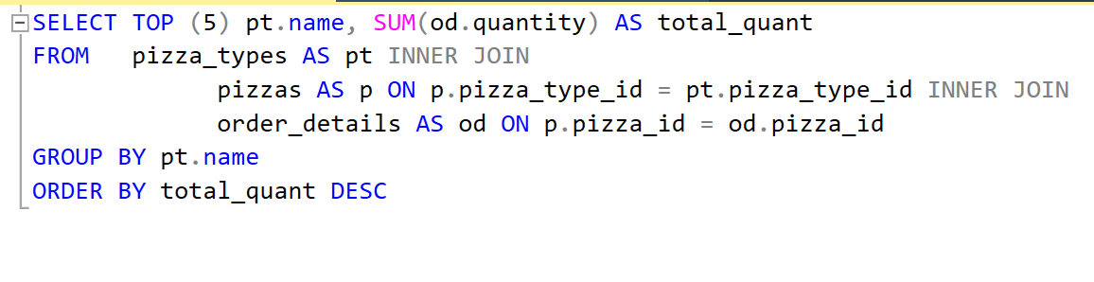
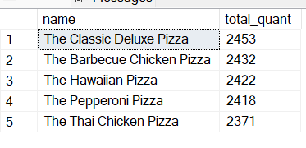
5.List the top 5 most ordered pizza types along with their quantities.

Slide 10
Intermediate Level Queries

Slide 11
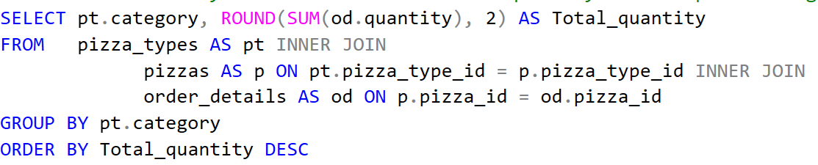
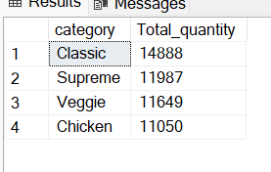
1.Join the necessary tables to find the total quantity of each pizza category ordered.

Slide 12
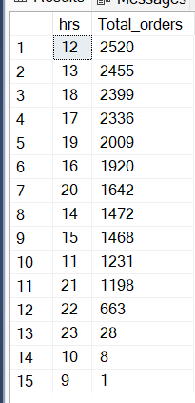
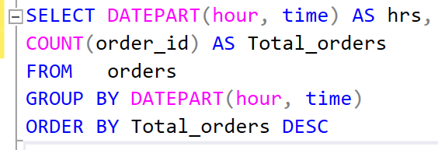
2.Determine the distribution of orders by hour of the day.

Slide 13
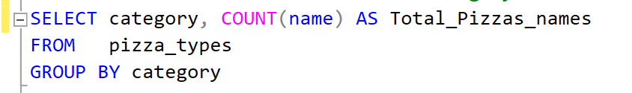
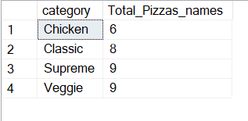
3.Join relevant tables to find the category-wise distribution of pizzas.

Slide 14
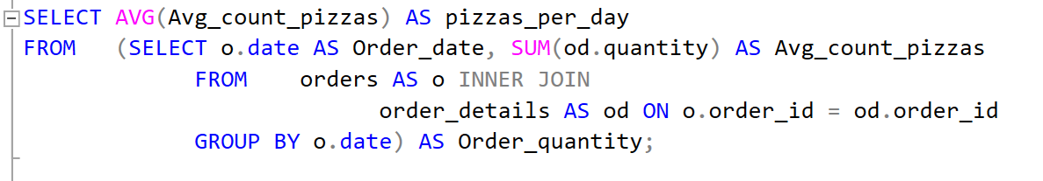
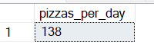
4.Group the orders by date and calculate the average number of pizzas ordered per day.

Slide 15
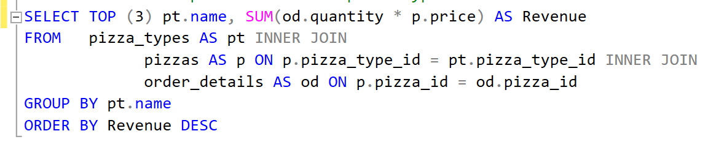
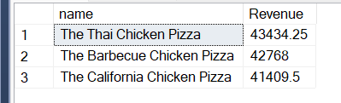
5.Determine the top 3 most ordered pizza types based on revenue.

Slide 16
Advanced Level Queries

Slide 17
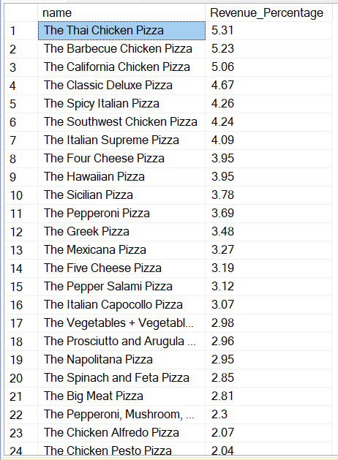
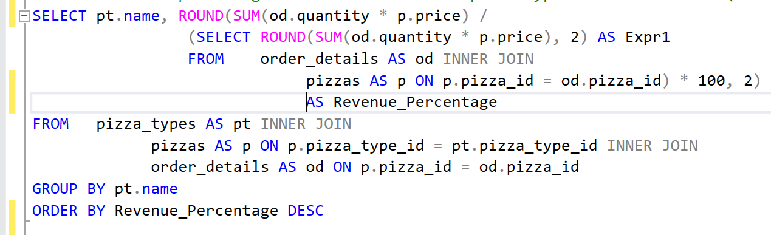
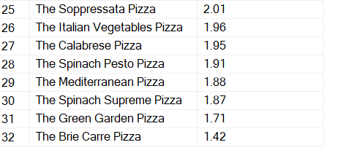
1.Calculate the percentage contribution of each pizza type to total revenue.(pizza name wise %)

Slide 18
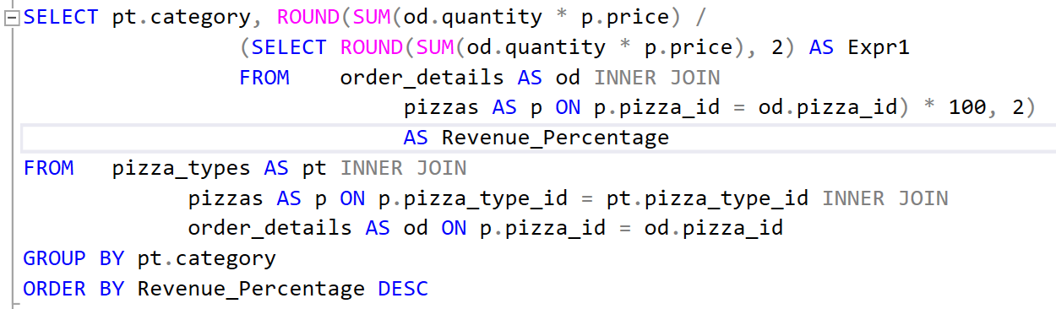
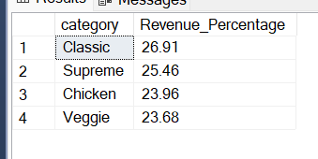
2.Calculate the percentage contribution of each pizza type to total revenue.(pizza category wise %)

Slide 19
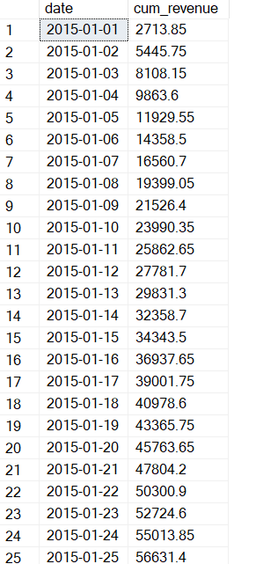
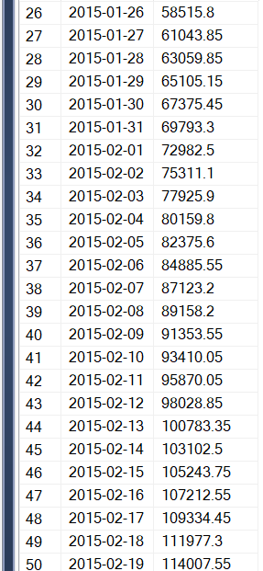
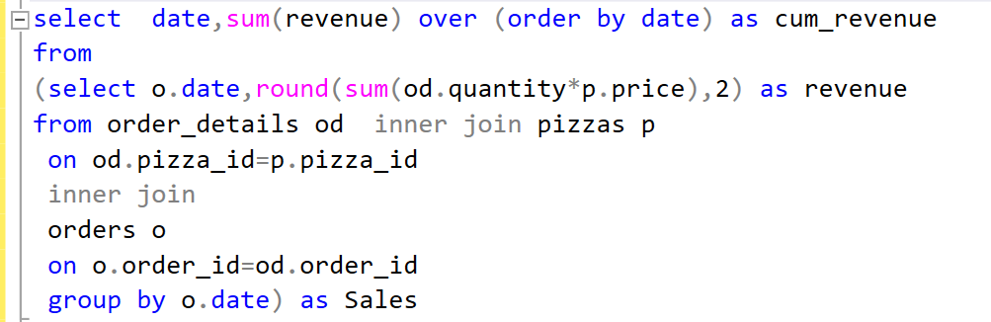
3.Analyze the cumulative revenue generated over time.

Slide 20
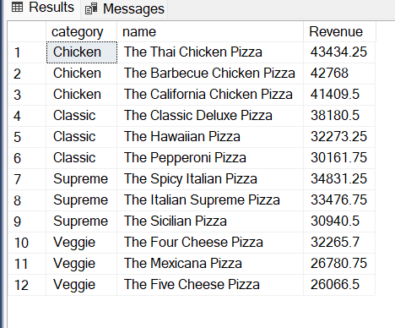
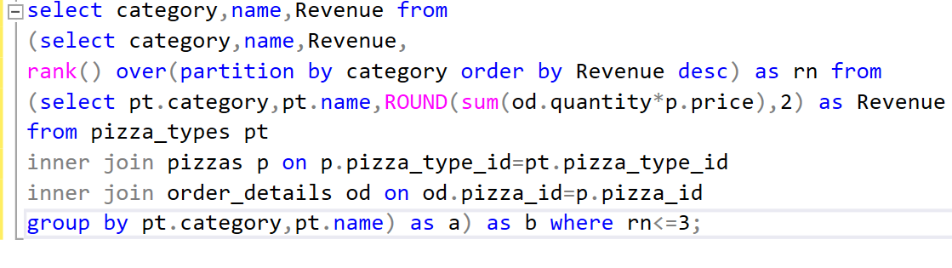
4.Determine the top 3 most ordered pizza types based on revenue for each pizza category.

Slide 21
Key Insights
Sales Peaks:
Identified weekends and holidays as peak sales periods.
Popular Pizzas:
Margherita and Pepperoni are the top-selling pizzas.
Customer Segmentation:
Regular customers contribute significantly to sales.
Revenue Boosters:
Promotions and combo offers drive higher sales.

Slide 22
Tools & Techniques
Data Extraction and Cleaning:
Ensuring data accuracy and consistency.
Data Analysis:
Leveraging SQL for querying sales data and
generating insights.

Slide 23
Thank you

